Slide 1


UBSUP - DTF project - KENYA
Operation of a Co-composting facility

Slide 2
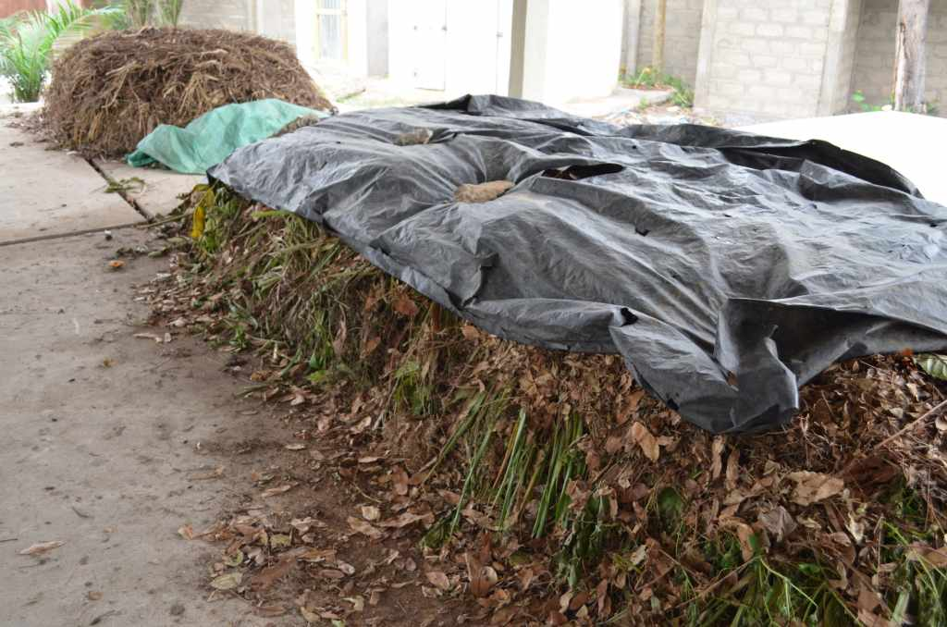

Slide 3
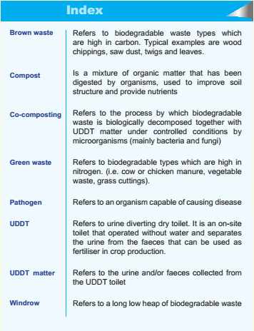
Keywords
User’s guide page 4

Slide 4
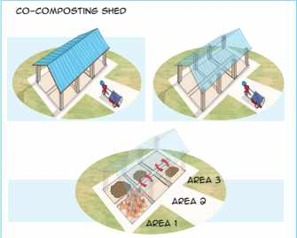
Co-composting shed
User’s guide page 4
3 Areas of 2 chambers each:
Area 1: offload and storage of raw material (waste and UDDT waste) and storage of mature compost
Area 2 and 3: co-composting process. 2 windrows maximum

Slide 5
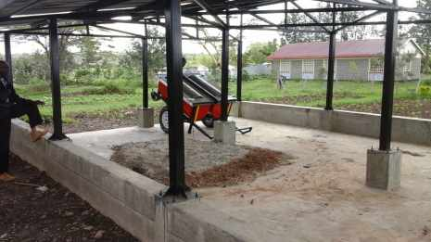
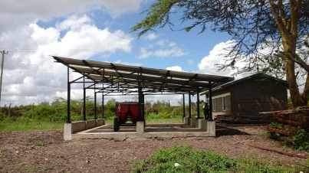
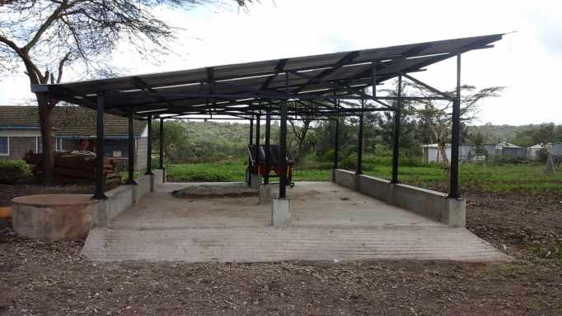
Co-composting shed in Oloolaiser

Slide 6
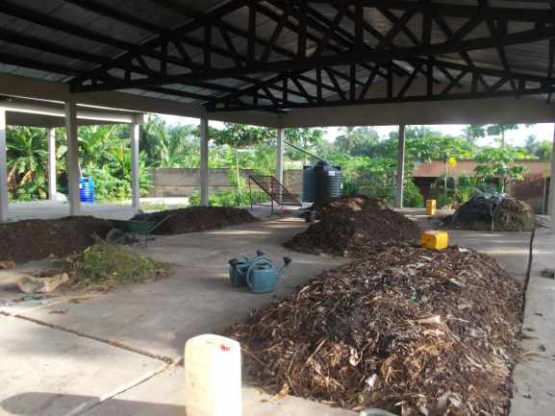
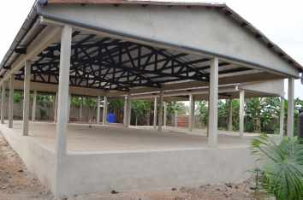
Co-composting shed in Benin (West Africa)

Slide 7
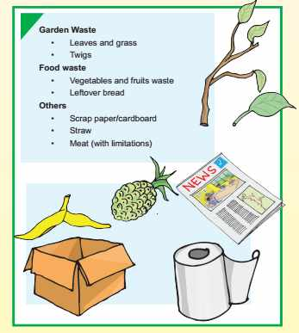
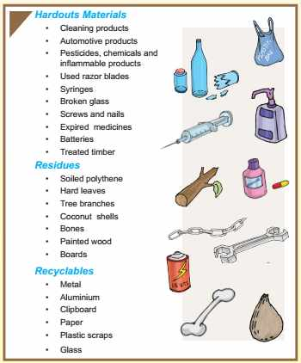
Material for co-composting
User’s guide page 5 and 6
YES
NO

Slide 8
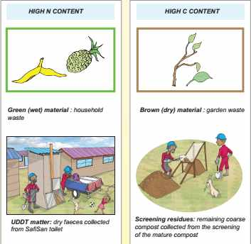
Composition of a windrow
User’s guide page 7 and 8
N = Nitrogen
C = Carbon
Nitrogen and Carbon is food for micro-organisms

Slide 9
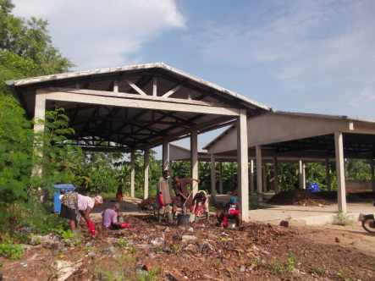
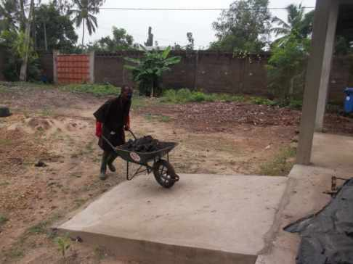
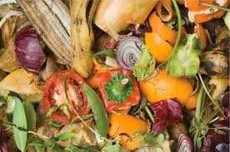
Green waste
Co-composting project in Benin

Slide 10
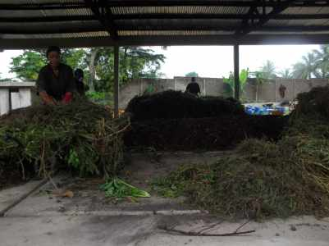
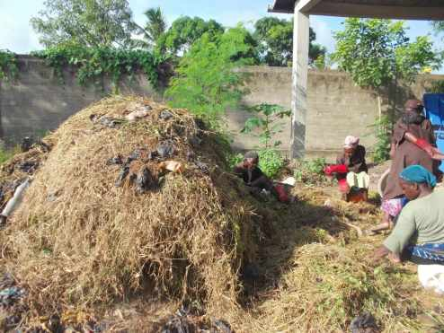
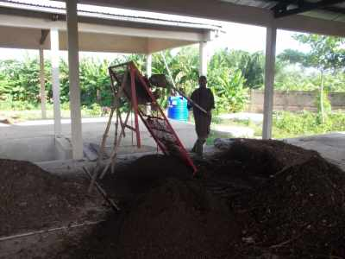
Brown waste
Co-composting project in Benin

Slide 11
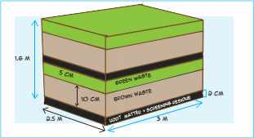
Composition of a windrow
User’s guide page 7 and 8
Dimension:
Length: 3m ; Width: 2.5m ; Height: 1.6m
Consecutive layers:
UDDT matter and screening residue (2 cm)
Brown waste (10 cm)
Green waste (5 cm)
Ideal combination to be determined by YOU (trials and errors)
Too wet: add more brown waste
Too dry: add more green waste

Slide 12
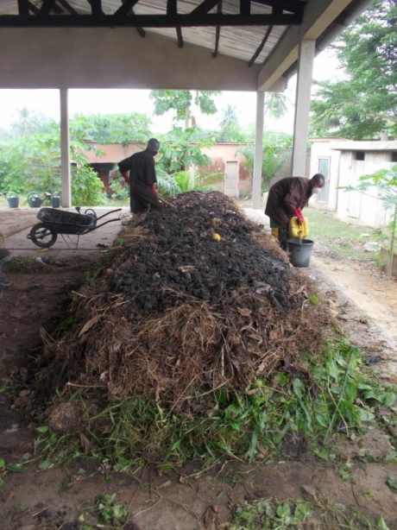
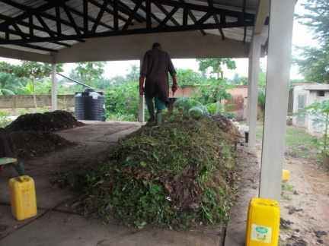
Windrow layers
Co-composting project in Benin

Slide 13
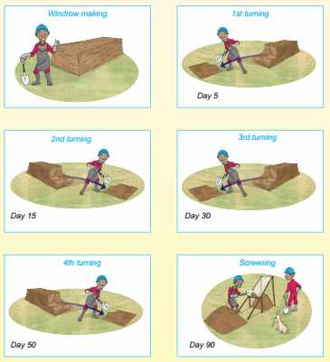

Windrow turning
User’s guide page 9 and 10
Co-composting process: 3 months
Turning → Air supply
Favour growth of micro-organism
Prevent odours
Turning schedule to be determined by YOU (trial and errors)
Recommendation: 3 to 6 turnings in total

Slide 14
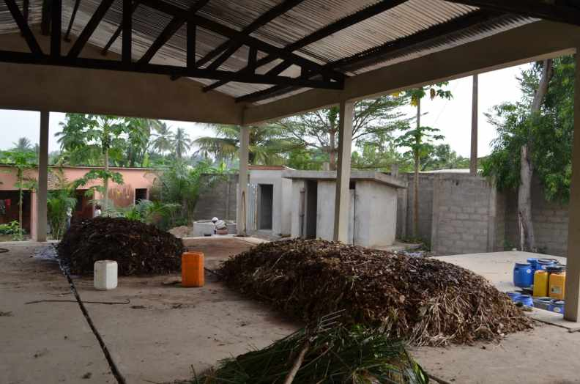
Windrow turning
Co-composting project in Benin

Slide 15

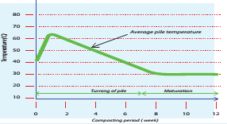
Evolution of a windrow: moisture and temperature
User’s guide page 11 and 13
Moisture content between 40 to 60% all throughout
Temperature must not exceed 70°C because it prevents microbiological activities.
Week 0 to 1: around 65°C → favour rapid composting and kill weed seeds, insect larvae and pathogens
Week 1 to 7: gradual decrease from 65°C to ambient temperature
Week 7 to 12: stabilization at ambient temperature

Slide 16
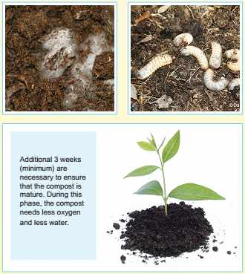
Maturation process
User’s guide page 14
Last turning: day 50th
Colour → Dark brown (soil like)
Temperature → below 50°C
Small insects and fungus (white stains) necessary to break down complex organic material

Slide 17
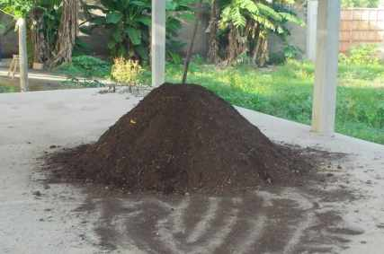
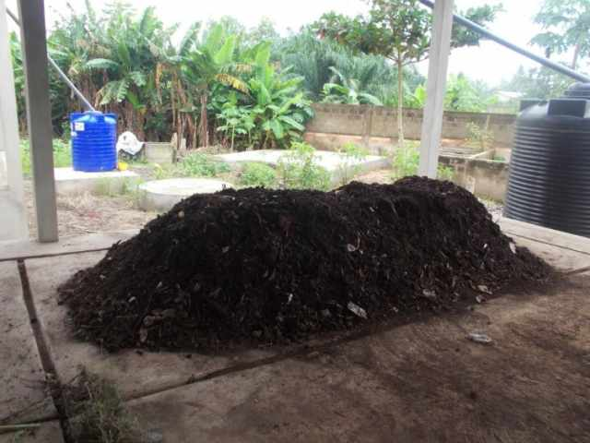
Mature compost
Co-composting project in Benin

Slide 18
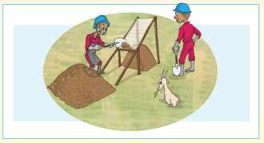
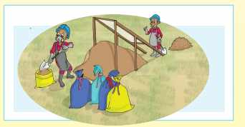
Screening / storage and bagging
User’s guide page 15
Mature compost is screened onto the sieve (5 to 10mm mesh size)
Screening residue used to make a new windrow
Fine compost is stored in bulks or bags before selling.
Compost cannot be stored in bags more than 1 year (risk of dry-out)

Slide 19
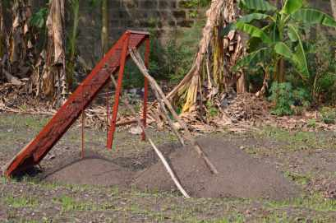

Screening
Co-composting project in Benin

Slide 20
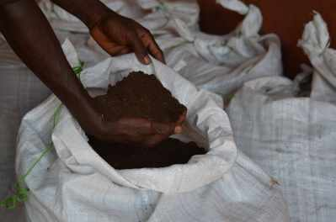
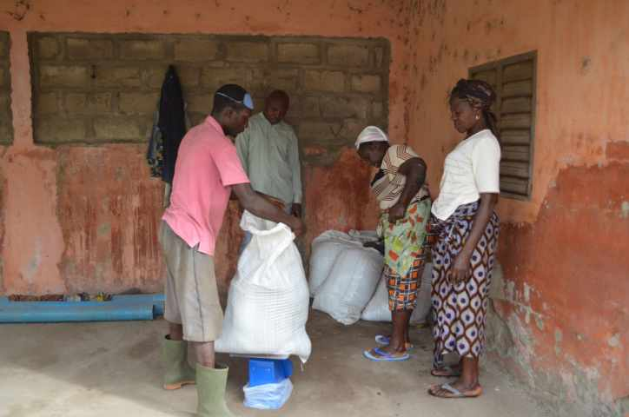
Bagging
Co-composting project in Benin

